Slide 1


University Institute of Engineering
DEPARTMENT OF COMPUTER SCIENCE & ENGINEERING
Subject Name: Software Engineering
Subject Code: 23CST-206
Er. Jagmeet Kaur
E8387
ASSISTANT PROFESSOR
CSE
DISCOVER . LEARN . EMPOWER

Slide 2
Introduction to Software Engineering
Course Outcome
CO Number | Title | Level
CO1 | Define principles and working of software process models. | Understand
CO2 | Describe agile development methodology and analyse where to apply. | Remember

Slide 3
Topics covered
Software Development life Cycle models
Waterfall model
Iterative Waterfall model
Prototype model
Evolutionary model
Spiral model

Slide 4
Software life cycle model
A software life cycle model is a descriptive and diagrammatic representation of the software life cycle.
A life cycle model represents all the activities required to make a software product transit through its life cycle phases.
It captures the order in which these activities are to be undertaken.

Slide 5
CPU
Classical Waterfall Model
Classical waterfall model divides life cycle into phases:
feasibility study,
requirements analysis and specification,
design,
coding and unit testing,
integration and system testing,
maintenance.

Slide 6
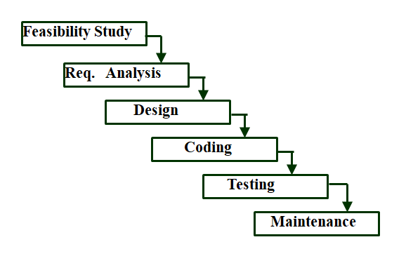
CLASSICAL WATERFALL MODEL
Fig 1 Classical Waterfall Model

Slide 7
FEASIBILITY STUDY
Main aim of feasibility study: determine whether developing the product
financially worthwhile
technically feasible.
First roughly understand what the customer wants:
different data which would be input to the system,
processing needed on these data,
output data to be produced by the system,
various constraints on the behaviour of the system.

Slide 8
FEASIBILITY STUDY
Work out an overall understanding of the problem.
Formulate different solution strategies.
Examine alternate solution strategies in terms of:
resources required,
cost of development, and
development time.

Slide 9
REQUIREMENT ANALYSIS AND SPECIFICATION
Aim of this phase:
understand the exact requirements of the customer,
document them properly.
Consists of two distinct activities:
requirements gathering and analysis
requirements specification.

Slide 10
REQUIREMENT GATHERING
Gathering relevant data:
usually collected from the end-users through interviews and discussions.
For example, for a business accounting software:
interview all the accountants of the organization to find out their requirements.

Slide 11
REQUIREMENT ANALYSIS
The data you initially collect from the users:
would usually contain several contradictions and ambiguities:
each user typically has only a partial and incomplete view of the system.

Slide 12
DESIGN
Design phase transforms requirements specification:
into a form suitable for implementation in some programming language.
In technical terms:
during design phase, software architecture is derived from the SRS document.
Two design approaches:
traditional approach,
object oriented approach.

Slide 13
IMPLEMENTATION
Purpose of implementation phase (aka coding and unit testing phase):
translate software design into source code.
During the implementation phase:
each module of the design is coded,
each module is unit tested
tested independently as a stand alone unit, and debugged,
each module is documented.

Slide 14
INTEGRATION AND SYSTEM TESTING
Different modules are integrated in a planned manner:
modules are almost never integrated in one shot.
Normally integration is carried out through a number of steps.
During each integration step,
the partially integrated system is tested.
After all the modules have been successfully integrated and tested:
system testing is carried out.
Goal of system testing:
ensure that the developed system functions according to its requirements as specified in the SRS document.

Slide 15
MAINTENANCE
Maintenance of any software product:
requires much more effort than the effort to develop the product itself.
development effort to maintenance effort is typically 40:60.

Slide 16
Advantages
Simple and easy to understand and use
Easy to manage due to the rigidity of the model. Each phase has specific deliverables and a review process.
Phases are processed and completed one at a time.
Works well for smaller projects where requirements are very well understood.
Clearly defined stages.
Well understood milestones.
Easy to arrange tasks.
Process and results are well documented.

Slide 17
Disadvantages
No working software is produced until late during the life cycle.
High amounts of risk and uncertainty.
Not a good model for complex and object-oriented projects.
Poor model for long and ongoing projects.
Not suitable for the projects where requirements are at a moderate to high risk of changing. So, risk and uncertainty is high with this process model.
It is difficult to measure progress within stages.
Cannot accommodate changing requirements.
Adjusting scope during the life cycle can end a project.

Slide 18
Application
Requirements are very well documented, clear and fixed.
Product definition is stable.
Technology is understood and is not dynamic.
There are no ambiguous requirements.
Ample resources with required expertise are available to support the product.
The project is short.

Slide 19
ITERATIVE WATERFALL MODEL
Classical waterfall model is idealistic:
assumes that no defect is introduced during any development activity.
in practice:
defects do get introduced in almost every phase of the life cycle.
Defects usually get detected much later in the life cycle:
For example, a design defect might go unnoticed till the coding or testing phase.
Once a defect is detected:
we need to go back to the phase where it was introduced
redo some of the work done during that and all subsequent phases.
Therefore we need feedback paths in the classical waterfall model.

Slide 20
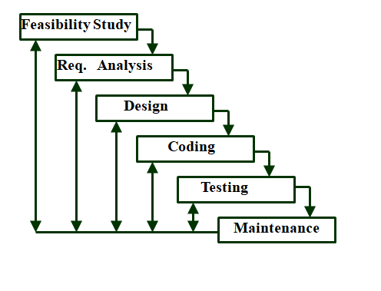
ITERATIVE WATERFALL MODEL
Fig 2 Iterative Waterfall Model

Slide 21
PROTOTYPING MODEL
Before starting actual development,
a working prototype of the system should first be built.
A prototype is a toy implementation of a system:
limited functional capabilities,
low reliability,
inefficient performance.
Start with approximate requirements.
Carry out a quick design.
Prototype model is built using several short-cuts:
Short-cuts might involve using inefficient, inaccurate, or dummy functions.
A function may use a table look-up rather than performing the actual computations.

Slide 22
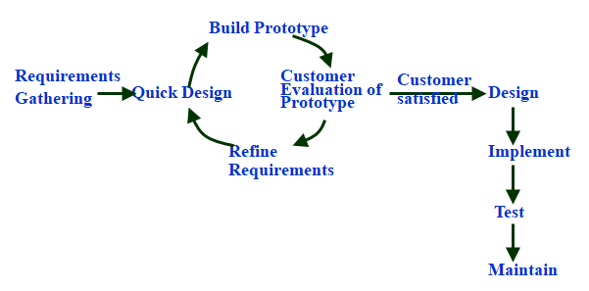
PROTOTYPING MODEL
Fig 3 Prototype model

Slide 23
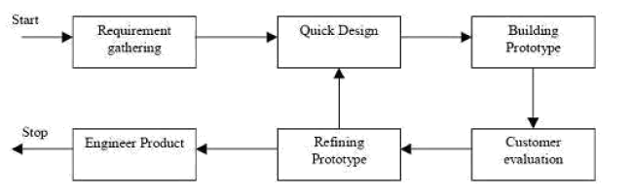
Prototype Model
Fig 4 Steps of prototype model

Slide 24
Advantages
Users are actively involved in the development
Since in this methodology a working model of the system is provided, the users get a better understanding of the system being developed.
Errors can be detected much earlier.
Quicker user feedback is available leading to better solutions.
Missing functionality can be identified easily

Slide 25
Disadvantages
Leads to implementing and then repairing way of building systems.
Practically, this methodology may increase the complexity of the system as scope of the system may expand beyond original plans.
Incomplete application may cause application not to be used as the full system was designed Incomplete or inadequate problem analysis.

Slide 26
When to use
Prototype model should be used when the desired system needs to have a lot of interaction with the end users.
Typically, online systems, web interfaces have a very high amount of interaction with end users, are best suited for Prototype model. It might take a while for a system to be built that allows ease of use and needs minimal training for the end user.
Prototyping ensures that the end users constantly work with the system and provide a feedback which is incorporated in the prototype to result in a useable system. They are excellent for designing good human computer interface systems.

Slide 27
Evolutionary Model
Evolutionary model (aka successive versions or incremental model):
The system is broken down into several modules which can be incrementally implemented and delivered.
First develop the core modules of the system.
The initial product skeleton is refined into increasing levels of capability:
by adding new functionalities in successive versions.
Successive version of the product:
functioning systems capable of performing some useful work.
A new release may include new functionality:
also existing functionality in the current release might have been enhanced.

Slide 28
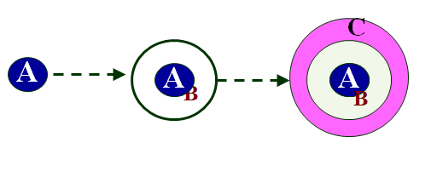
Evolutionary Model
Fig 5 Evolutionary Model

Slide 29
Spiral Model
Each loop of the spiral represents a phase of the software process:
the innermost loop might be concerned with system feasibility,
the next loop with system requirements definition,
the next one with system design, and so on.
The team must decide:
how to structure the project into phases.
Start work using some generic model:
add extra phases
for specific projects or when problems are identified during a project.
Each loop in the spiral is split into four sectors (quadrants).

Slide 30
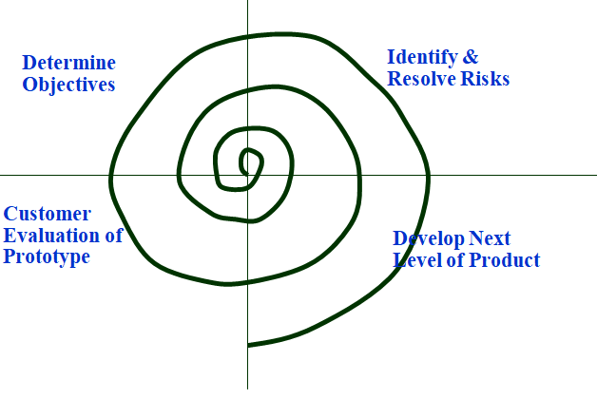
Spiral Model
Fig 6 Spiral Model

Slide 31
Spiral Model
Identify objectives of the phase,
Examine the risks associated with these objectives.
Risk:
any adverse circumstance that might hamper successful completion of a software project.
Find alternate solutions possible.

Slide 32
Advantages
Changing requirements can be accommodated.
Allows extensive use of prototypes.
Requirements can be captured more accurately.
Users see the system early.
Development can be divided into smaller parts and the risky parts can be developed earlier which helps in better risk management.

Slide 33
Disadvantages
Management is more complex.
End of the project may not be known early.
Not suitable for small or low risk projects and could be expensive for small projects.
Process is complex
Spiral may go on indefinitely.
Large number of intermediate stages requires excessive documentation.

Slide 34
APPLICATIONS
Managing clients requirements in industry.
Generating software for noticing health activities with novel smart technologies.
Content Management and to analyzing Fraud detection and Prevention
Advertisements Targeting Platforms Managing content, posts, images and videos on social media platforms
Analyzing customer data in real-time for improving business performance
Public sector fields such as intelligence, defense, cyber security and scientific research

Slide 35
REFERENCES
Reference Books:
Suman Ugrasen, “Software Engineering - Concepts and Practices”, First Edition, Cengage.
Mohammad Ali Shaikh, “Software Engineering with UML”, Third Edition, Notion Press.
Somerville Ian, “Software Engineering”, Addison Wesley, 8th Edition.
Text Books:
Pressman Rogers, “Software Engineering: A Practitioner's Approach”, Sixth edition. Patterson and Hennessy, “Computer Architecture” , Fifth Edition Morgaon Kauffman.
Rajib Mall, “Fundamentals of Software Engineering’’, Fourth Edition, Pearson, PHI.
Reference Website
https://www.javatpoint.com/software-engineering-sdlc-models

Slide 36
IMAGE REFERENCES
Fig 1 https://www.javatpoint.com/software-engineering-sdlc-models
Fig 2 https://flexagon.com/blog/7-software-development-models-you-should-know/
Fig 3 https://www.javatpoint.com/software-engineering-sdlc-models
Fig 4 https://flexagon.com/blog/7-software-development-models-you-should-know/
Fig 5 https://www.javatpoint.com/software-engineering-sdlc-models
Fig 6 http://swebokwiki.org/Chapter_9:_Software_Engineering_Models

Slide 37
THANK YOU

